Slide 1

Chapter 1 : Introduction
By : Prof. Patrick :P
System Security: B.Tech Integrated (Sem VII)
Chapter Taken From :.
Principles of Information Security , Whitman
Security in Computing , Pfleeger

Slide 2

Contents (3 Hours)
Basic Components of Computer Security (CIA) / Goals of Security *****
Vulnerabilities ****
Threats ****
Attacks ****
Controls **
Computer Criminals ***

Slide 3
From Where I should Study ? :P
Contents | Resource Material
Basic Components of Computer Security (CIA) / Goals of Security | Notes Will be provided
Vulnerabilities Threats | Notes Will be provided
Attacks | Notes Will be provided
Controls | Notes Will be provided
Computer Criminals | Notes Will be provided

Slide 4
How I will Teach ?
PPT
You Tube Videos
Some Live Case Studies on Internet
Discussions

Slide 5
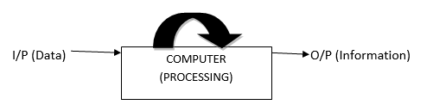
Pre-requisite ( What is Data , Information and Security )
The term “Information” is a collection of relevant data, which gives us meaningful knowledge about a particular entity. The information is always formed after processing of data. (Example : Ronny - Refer My Notes )
The SYSTEM SECURITY is the study of theoretical and real weaknesses and threats in computer-related system so that we can implement various protection mechanisms to protect the system. (Example : Ronny with Secure Data - Refer My Notes )

Slide 6
Goals of Security
The obvious question that one may ask: “when I say my system is secure? “
The answer looks difficult because no one has implemented a perfect security mechanism yet because attackers are always smarter than programmer’s .In general, system is said to be “SECURE” if there is proper control of: Confidentiality, Integrity, Availability (CIA). The major challenge is to achieve proper and right balance among these three goals.
Confidentiality
Integrity
Availability

Slide 7
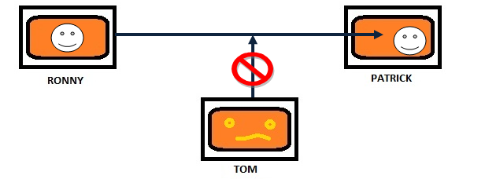

Goals of Security
Confidentiality
The term Confidentiality means only authorized people or system should access the data, Otherwise it is consider as Unauthorized Access.
To achieve confidentiality we used the “Encryption” technique that is message send by sender is encoded and then transmitted.
In fig. below Ronny sends message X to Patrick .Message X is encrypted before transmission so that even if Tom tries to attack on communication channel he will not get information.

Slide 8
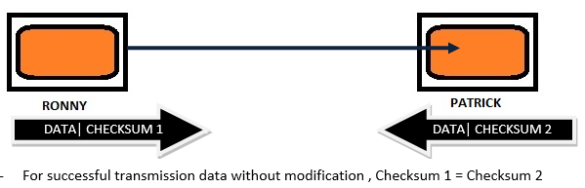
Goals of Security
Integrity
The term Integrity means only authorized party should modify the data send by receiver in authorized way and data should not be changed by attacker.
The modification includes writing, changing, deleting the data from database.
To preserve integrity we implement “Checksum”. Checksum is the binary block added with data part before transmission. The value of checksum should be preserved after transmission.

Slide 9
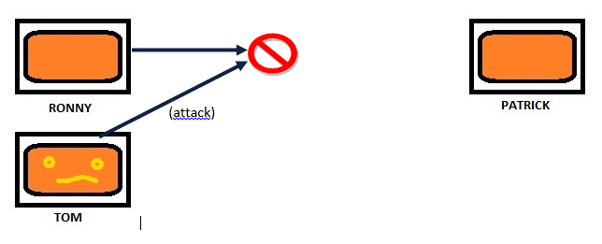
Goals of Security
Availability
The principle of availability states that data or resources should be available to authorized parties at all times. In other words, data or resources should reach to receiver as it is.
The goal of availability is preserved only
If there should be appropriate response to request made by receiver.
If the resources are available and no requester should be favored over others and system/service should be fault tolerance.
If Hardware and software are properly configured so that they can able to transmit data properly.
There should concurrency control for every Transaction. Deadlock management should be properly implemented.

Slide 10
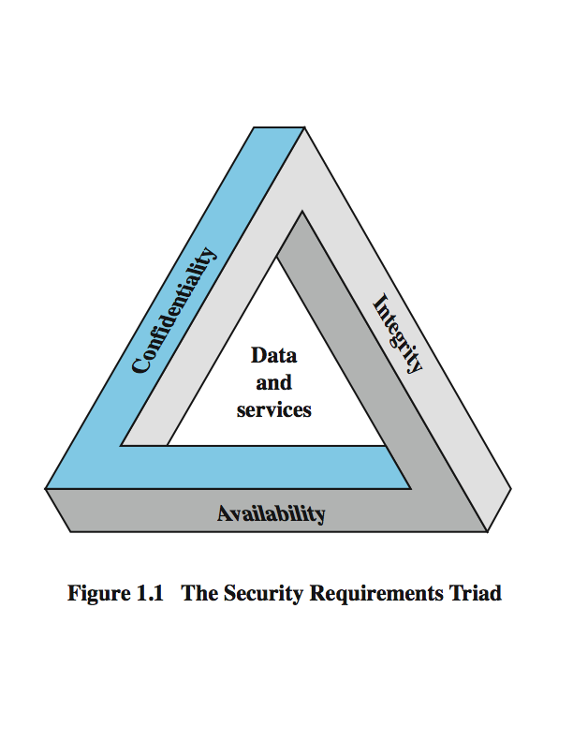
CIA TRIAD (Just for Information)

Slide 11
Boring ??? (Lets have a Video)

Slide 12
Vulnerabilities
The basic questions regarding to security that can arise in our mind are-
Why attackers attack our system?
Is there any weak component present in our system?
What are the precautions we need to take against attack?
Vulnerability is nothing but the Weakness in the system. Weakness in the system may exploit an attack. Weakness can be in coding, design or can be anything related to software development.
Types :
Hardware Vulnerability
Software Vulnerability
Data Vulnerability

Slide 13
Threats
A threat is a potential for violation of security or a possible danger that might exploit vulnerability.
In other words a threat is a set of activity that has ability to cause harm. The threat can be either generated by Human or Computer.
Threat is purposely created by an attacker to attack on the system. In other words, an exploitation of vulnerability is attack on the system.
There are four kinds of threats possible: Interception, Interruption, Modification, and Fabrication.

Slide 14
Threats
Interception :
Interception is keeping track of traffic without modification. In other words, some unauthorized system has gained access to an asset.
The unauthorized party can be a person, program or any computing device.
However Interception is very difficult to trace as silent interceptor leaves no traces while intercepting the data.
Interruption :
In interruption, the data may be lost or unavailable due to some unauthorized party.
There are various ways by which attacker can achieve interruption. Either attacker can break the line so that communication cannot be completed further.
The attacker can purposely send additional data on communication channel (called as Traffic) which will cause congestion on communication link.

Slide 15
Threats
Modification :
In modification, instead of intercepting or interrupting data is modified in some way. Receiver doesn’t have any knowledge of this modification.
Modification can be changing the values in particular database, altering the program execution flow, creating virus codes and appending it into program etc.
Fabrication :
In fabrication, attacker might hide his own identity and can send the data to receiver from some trusted host.
This can be done skillfully by an attacker so that receiver will get to know that data is coming from trusted host.
Fabrication is generally achieved by copying digital signature of trusted host and can append new malicious data.

Slide 16
Threat

Slide 17
Attacks
An exploitation of vulnerability is attack on the system. The threat in action is called as Attack.

Slide 18
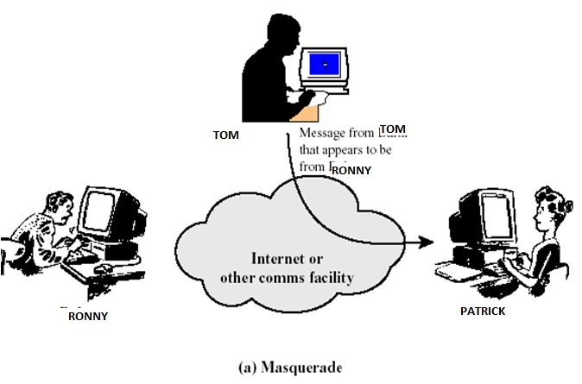
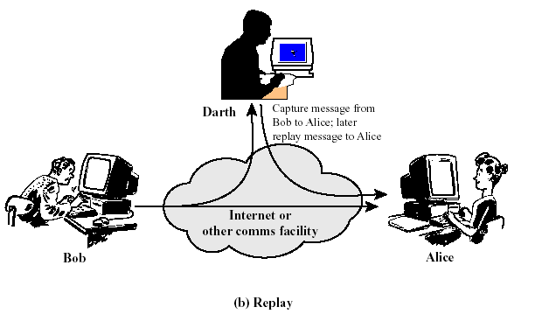
Attacks (Active)

Slide 19
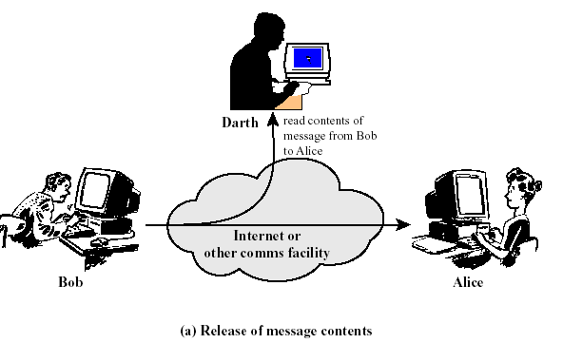
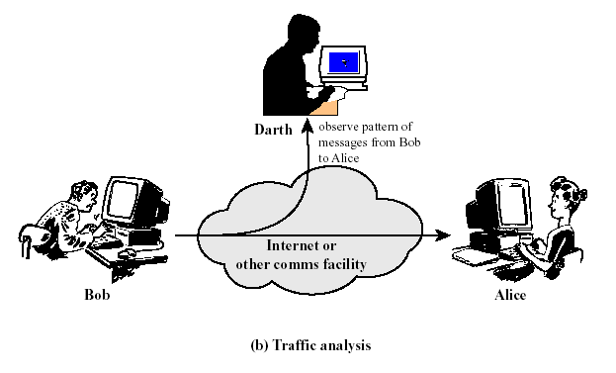
Attacks (Passive)

Slide 20
Controls
Control is an action, device, procedure or technique that removes or reduces vulnerability. Using Methods of defense the vulnerability in the system can be either removed or reduced in some way.
There are few standard control techniques are :
Hardware control
Physical control
Software control
Encryption

Slide 21
Computer Criminals
Computer Criminals are human being who purposely wants to destroy the security systems. They may have illegal access to software, data or hardware.
Computer criminals are of four types: Amateurs, Crackers, Career Criminals and Terrorists.
Amateurs
These are the people who only observe the weakness in our system. Amateur’s not necessarily bad people, they can be software developers also who observe vulnerability in their own software so that in future their software will be free from malicious attacks.

Slide 22
Computer Criminals
Crackers
These people are high-school or university students who have knowledge about security mechanisms. In other word all engineering student can be in this category.
Career criminals
These people are dangerous who understand targets of computer crime. They begin as computer professionals who engage in their crime, finding the prospects and pays off good.

Slide 23
Computer Criminals
Terrorists
These are the person who breaks security mechanisms in following ways.
1. Target of attack: web - site attacks and Denial of Service attack are popularly used for any political organizations because they want to bring undesired negative attention.
2. Propaganda vehicles: Using web-logs, email-lists are used to get message to many people.
3. Methods of attack: To launch offensive attacks requires use of computers.

Slide 24
THANK YOU

